Slide 1


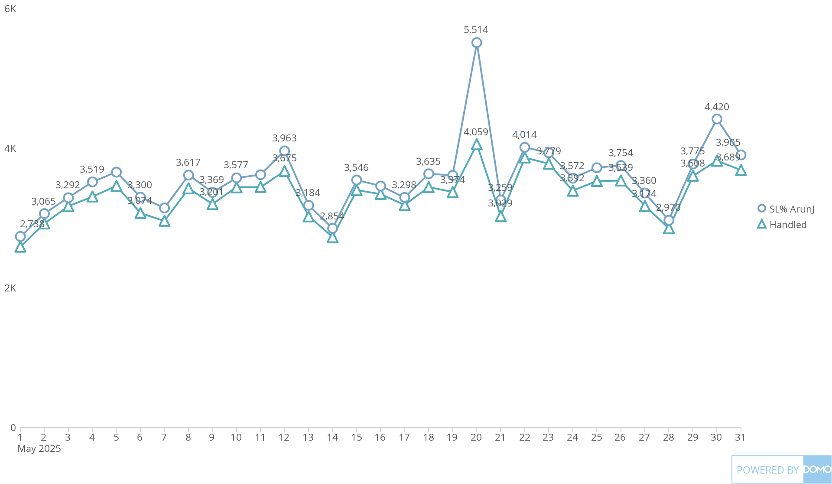
+
exported May 17, 2025, 12:37:00 PM UTC
PE3| | Card 2 | Service Level Alert
This Month, by Day
104K Sum of Handled

